Slide 1
اپیدمیولوژی و پیشگیری از آنفلوانزای H1N1
نوذر نخعی
آذر 1394

Slide 2
Antigenic Shift & Drift

Slide 4
چهار اپیدمی دنیا از ابتدای قرن بیستم

Slide 5
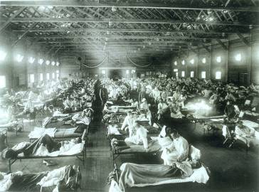
What about past flu pandemics?
Credit: US National Museum of Health and Medicine
1918: “Spanish Flu”
1957: “Asian Flu”
1968: “Hong Kong Flu”
A(H1N1)
A(H2N2)
A(H3N2)
20-40 m deaths
1-4 m deaths
1-4 m deaths
Notes:
As you can see, the Spanish Flu in 1918 was the most severe of the three pandemics resulting in 20 to 40 million deaths worldwide and 675,000 U.S. deaths. The Asian Flu pandemic resulted in double the usual number of flu season deaths in the US. The Hong Kong Flu pandemic was relatively mild by comparison.
Slide images and figures from online slide set of Barbara Wallace, New York State Department of Health 2005. Interestingly, the little girl in the picture is gargling, which was a commonly advocated defense against the flu during that period of time.

Slide 6
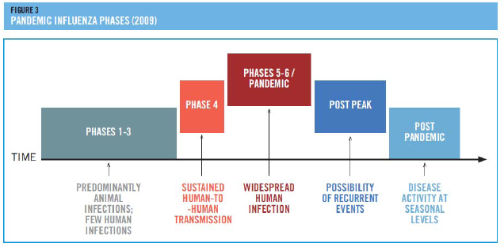
پاندمی چهارم
آوریل 2009 میلادی یا فروردین 1388
23 فروردین: مکزیک
26 فروردین: کالیفرنیا
در عرض 9 هفته (خرداد ماه): کل دنیا

Slide 8
15 تیرماه 1388

Slide 9
وضعیت آنفلوانزا تا آذر 1394

Slide 14
اپیدمیولوژی در آمریکا
In the United States between 5% and 20% of the population are infected with influenza every year, resulting in between 3,000 and 49,000 influenza-associated deaths

Slide 15
طغیان در هند 2015
The total number of laboratory conﬁrmed cases crossed 33000 mark with death of more than 2000 people.
The states of Gujarat and Rajasthan are the worst aﬀected

Slide 16
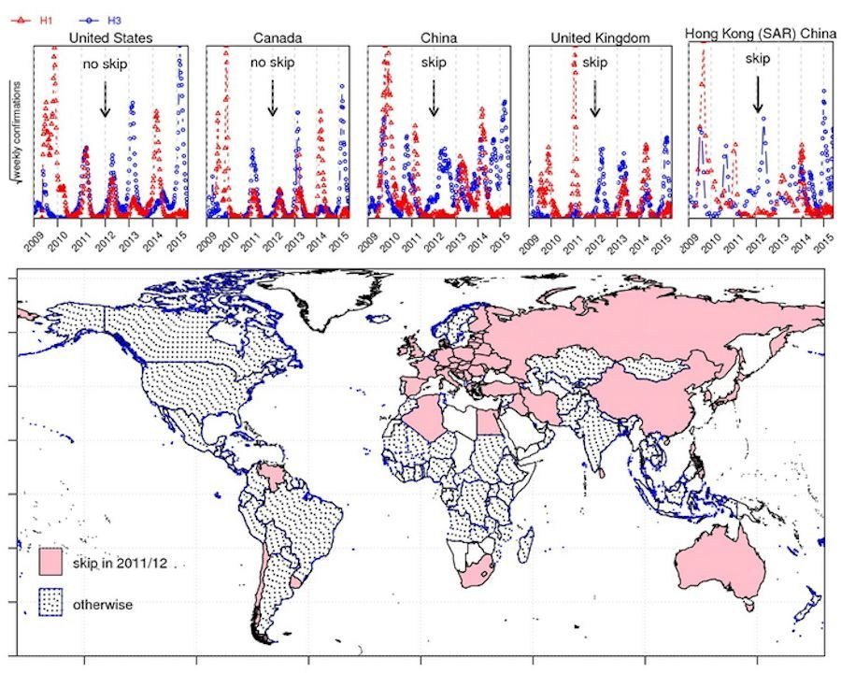

Slide 17
میزان حمله ثانویه و مرگ
Influenza occurs globally with an annual attack rate estimated at 5%–10% in adults and 20%–30% in children. Illnesses can result in hospitalization and death mainly among high-risk groups (the very young, elderly or chronically ill). Worldwide, these annual epidemics are estimated to result in about 3 to 5 million cases of severe illness, and about 250 000 to 500 000 deaths.

Slide 18
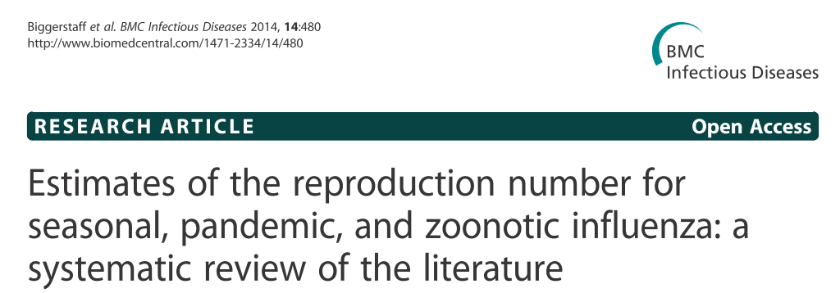
قدرت سرایت
یک بیمار به طور متوسط چند نفر فرد غیر ایمن را بیمار میکند؟
The median R value for 2009 was 1.46 (IQR: 1.30 – 1.70)

Slide 19
The overall attack rate (AR) was 25 % , and was highest (41 %) in grade 4 pupils, where the outbreak started.

Slide 20
استراتژی های پاسخ به اپیدمی
Antiviral drugs
Vaccines, etc
Medical care, PPE
اقدامات
پزشکی
اقدامات غیرپزشکی
Personal hygiene
Travel restriction
Quarantine
Social distancing
Risk Communication
اقدامات بهداشت عمومی
خدمات اجتماعی
(واداشتن جامعه به تحرک)
Security
Food & water supply
Power supply
Transportation
Telecommunication
other essential services
Notes:
So what we need prepare for Phase 6.
We have to prepare medical intervention and non medical intervention such as social distancing. They are called public health intervention, and the health department can take a lead in most of these activities.
But in phase 6, in addition to public health measures, operation required in general disaster are needed.

Slide 21
دو راه اصلی انتقال

Slide 22
هاله یک متری

Slide 23
بازه زمانی مسری بودن
3-5 days from clinical onset in adults;
Up to 7 days in young children
Peak viral shedding occurs on day 1 of symptoms

Slide 24
بنابراین:
پیشگیری کار پیچیده ای نیست!
محور پیشگیری بر اقدامات بهداشتی و حفاظت فردی استوار است.
و ......

Slide 25
چگونه از خود و دیگران محافظت کنیم؟

Slide 26
چگونه از خود و دیگران محافظت کنیم؟

Slide 28
واکسن های موجود در دنیا

Slide 29
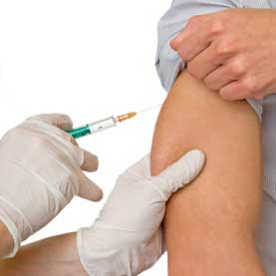
واکسن

Slide 30
اولویت های واکسیناسیون
اولویت نخست با خانم های باردار است.

Slide 31
واکسیناسیون در بارداری
CDC recommends that pregnant women get a flu shot during any trimester of their pregnancy to protect themselves, their unborn babies, and their newborn babies from flu. The nasal spray vaccine is not recommended for use in pregnant women

Slide 32
اثربخشی واکسن

Slide 33
خصوصیات واکسن
It usually takes 2 to 3 weeks for the protection against these viruses to be effective, and the protection lasts for 6 to 12 months
شامل سه ویروس غیر فعال:
H1N1
H3N2
B

Slide 34
نحوه تزریق و دوز
• Adults and children over 35 months: A single injection (0.5mL)
• Children 6 months to 35 months: A single injection (0.25mL), require a second injection a month later.

Slide 35
GBS
Attributable risk of 0.95 / 100,000 vaccinees
• Risk concentrated within first 6 weeks of
vaccination (peak at week 2 – 3)
منع مطلق:
Severe allergic reaction (e.g., anaphylaxis) after previous dose of any influenza vaccine; or to a vaccine component, including egg protein

Slide 36
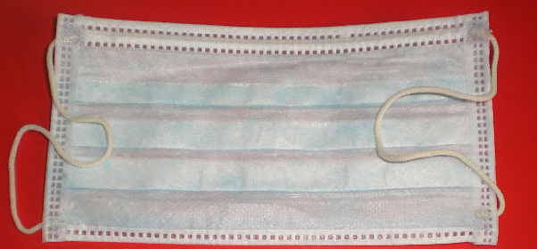
انواع ماسک
Filters at least 95% of airborne particles
Typical 3-ply surgical masks.

Slide 37
Dust Mask

Slide 38
استفاده از ماسک
There is no evidence that wearing face masks (e.g. surgical-type) outside of healthcare settings during the influenza season or a pandemic offers effective protection or reduces transmission, and ECDC does not
recommend their use.

Slide 42
نکات مهم
• Do not let the mask hanging from the neck.
• Change the mask after six hours or as soon as they become wet.
• Disposable masks are never to be reused and should be disposed off.
• While removing the mask great care must be taken not to touch the potentially
infected outer surface of the mask

Slide 43
از توجه شما متشکرم

